Slide 1
VACUUM CIRCUIT BREAKER OPERATION

Slide 2
VACUUM CIRCUIT BREAKER
A circuit breaker is a device that interrupts an electric circuit to prevent fault current, caused by a short circuit or overload.
A vacuum circuit breaker is a kind of circuit breaker where the arc quenching takes place in a vacuum medium. It consisted of completely sealed vacuum interrupter for 3 phase AC current which performs basic functions such as opening and closing of VCB. It is used in sub-stations, industries, star hotels, factories, and high voltage requirements.

Slide 3
HOW TO USE THIS PRODUCT
Vacuum circuit breaker is attached with a dedicated switchgear panel to serve as switchgear.
The incoming supply is connected to the switchgear panel and outgoing is given to the external product.
The relay senses the fault occurred and transmits the signal to the vacuum circuit breaker.
The breaker trips the circuit automatically by spring charging mechanism.
After the fault is cleared, circuit may be closed with the help of breaker by manually pushing the closing coil button or it can be closed with the help of remote access.
Since all processes are automated, only installation is enough to use this product.

Slide 4
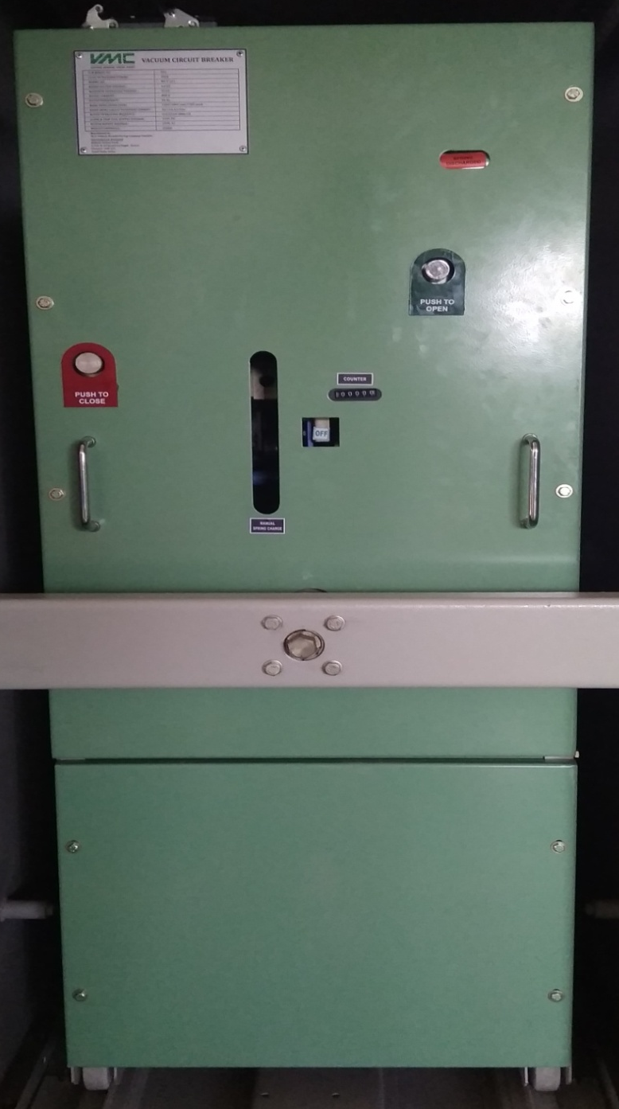
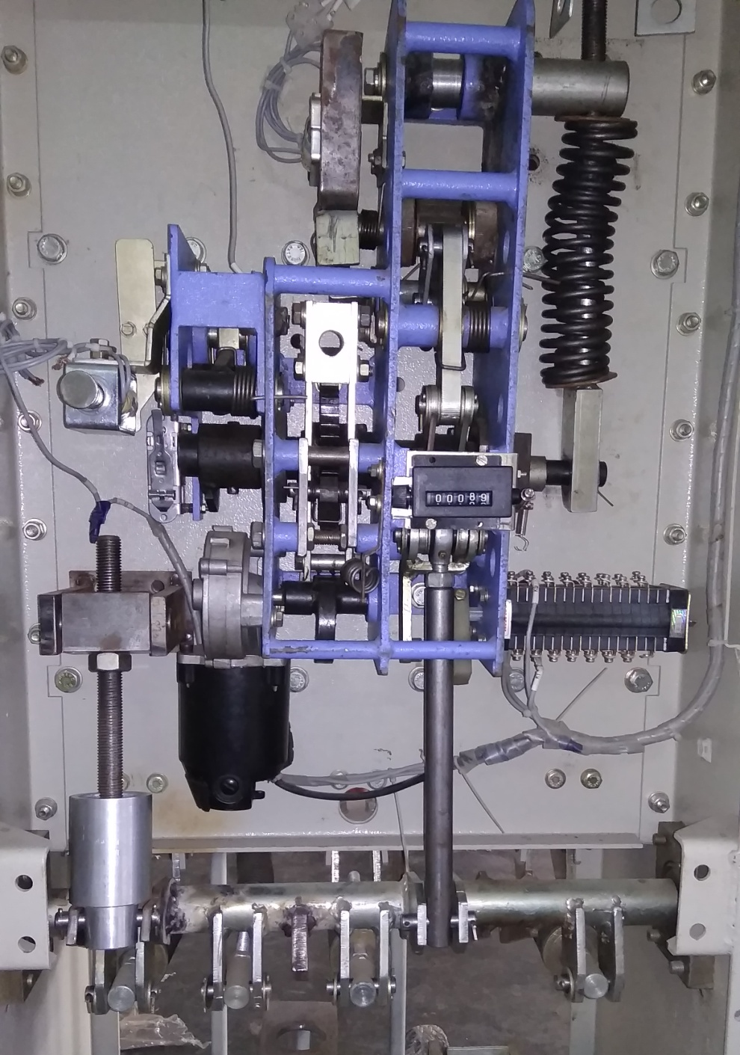
BREAKER ASSEMBLY (FRONT)

Slide 5
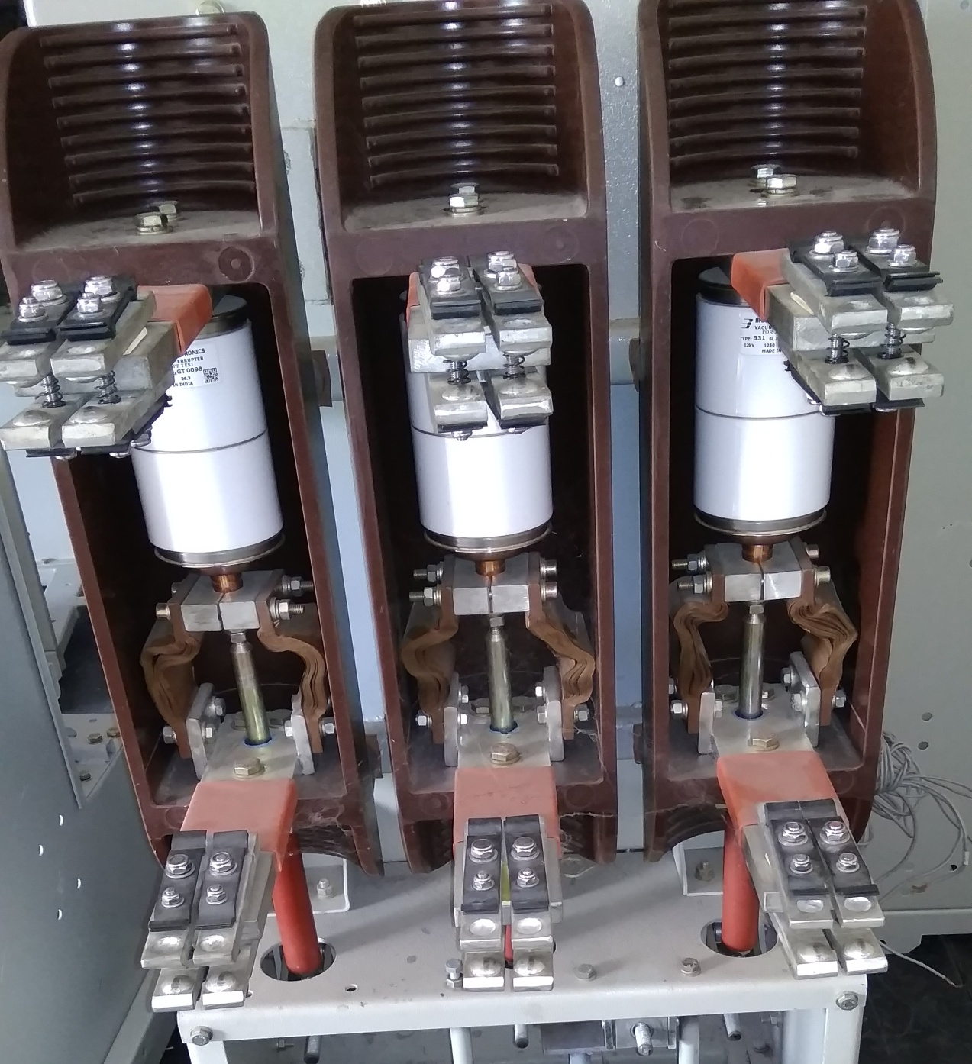
BREAKER ASSEMBLY (BACK)

Slide 6
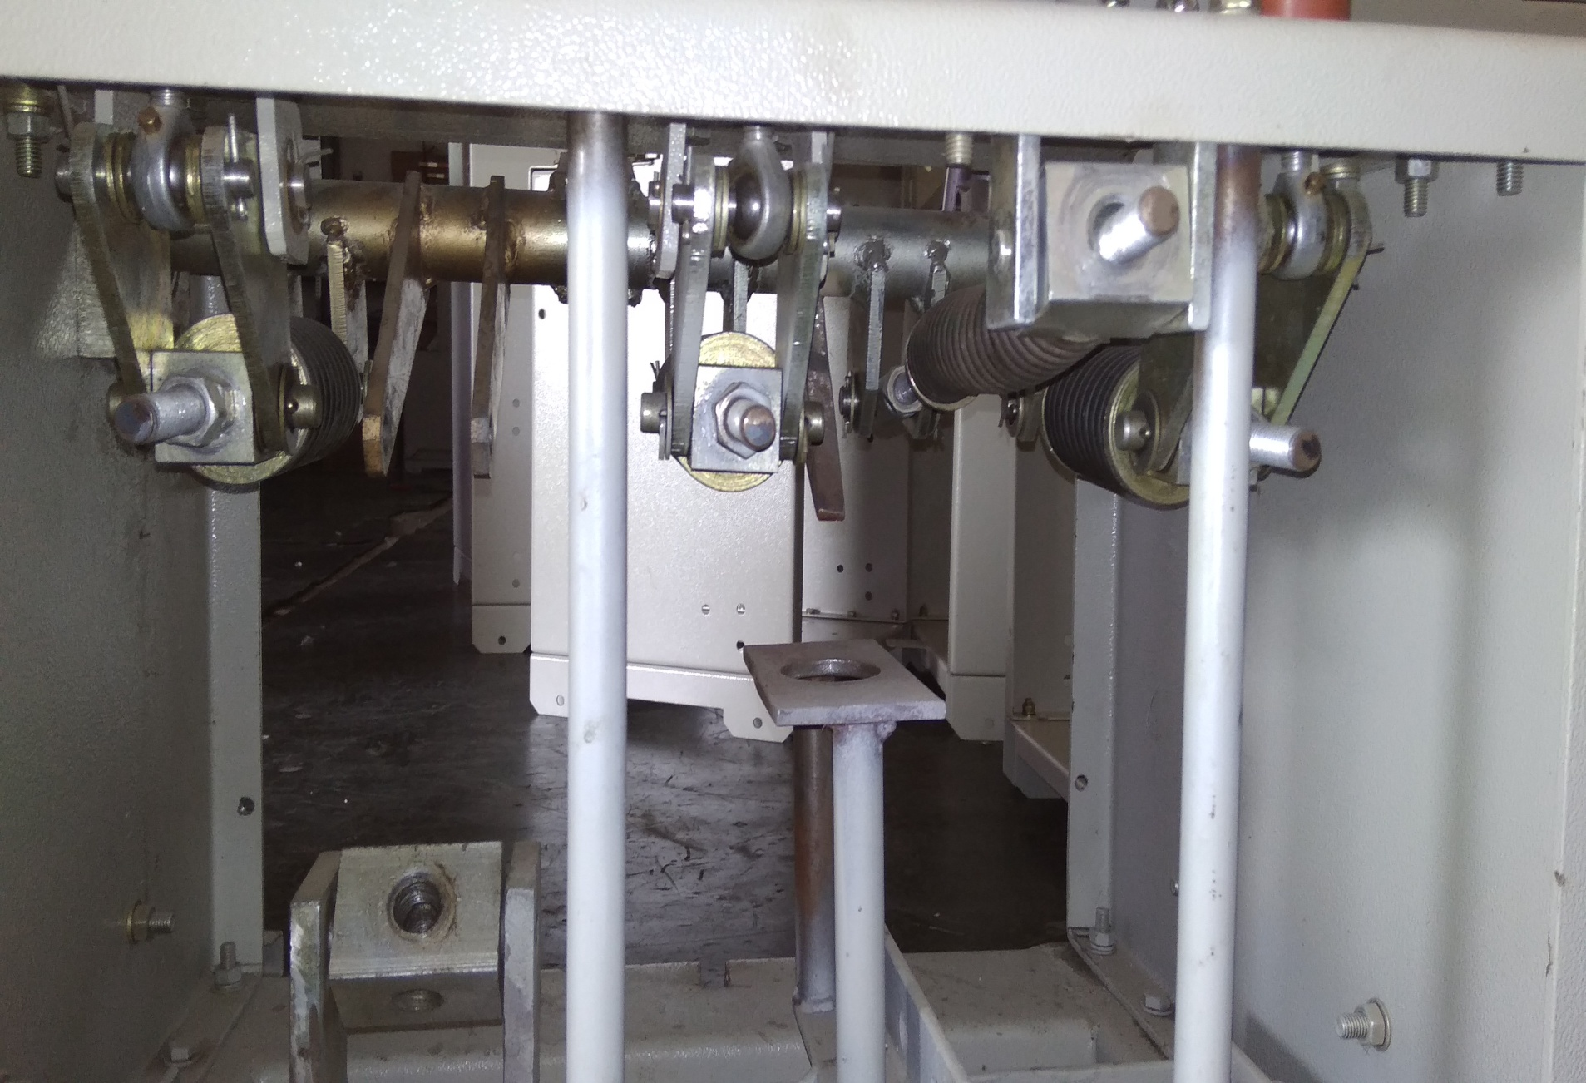
BREAKER ASSEMBLY (BOTTOM)

Slide 7
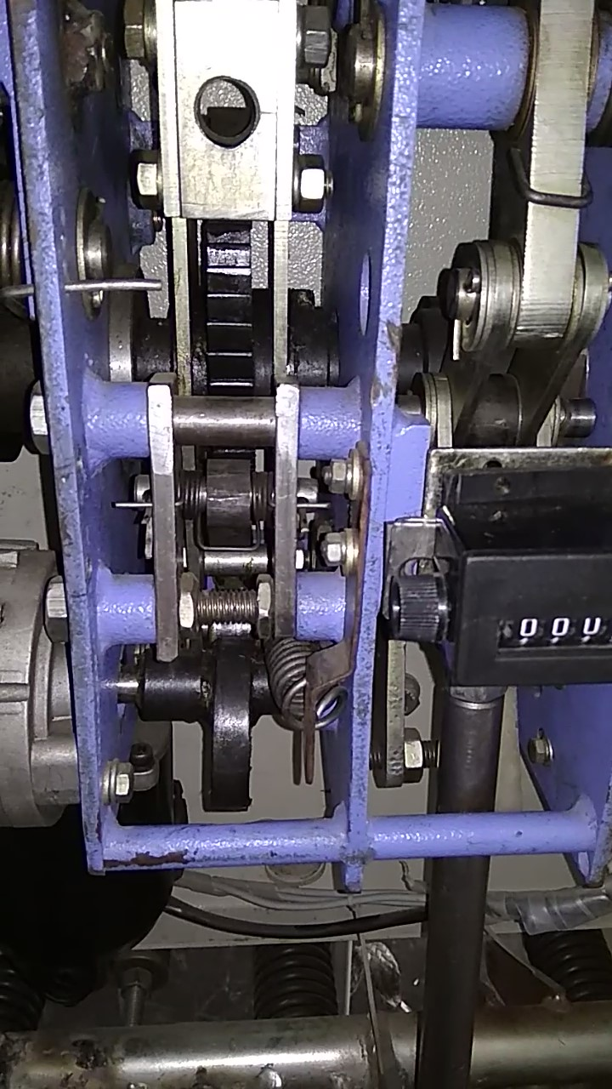
BREAKER OPERATIONS
CHARGING
Spring charging motor mechanism incorporates a cam attached with rotor to change the closing spring.
The charging is done by a ratchet(with curved tooth) mounted on the main shaft.
The motor will run until reaches the limit switch thereby positioning the cam in the correct position.

Slide 8
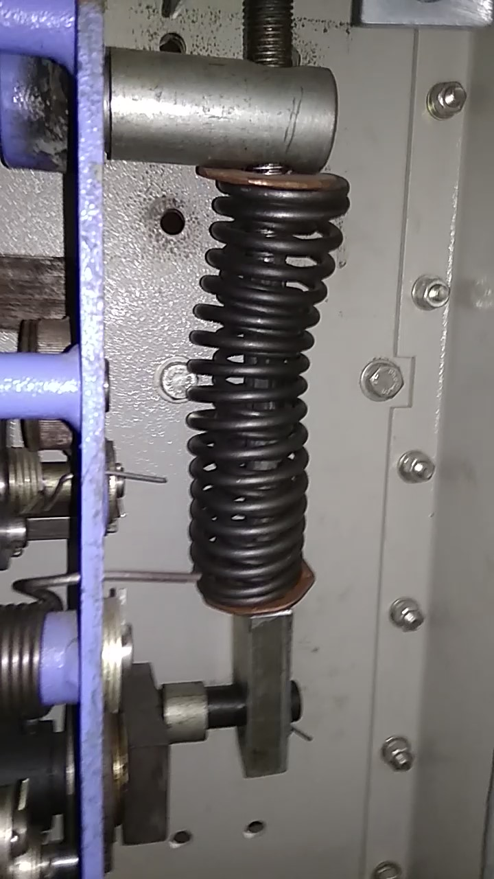
COMPRESSION
The closing spring (open coil helical spring) is charged or compressed by spring charge motor mechanism or by manual cranking.
The fully compressed position also makes the cam to be in the vertical position (being ready to close the breaker i.e. to hit the linkage roller)
This closing coil will always be in the compressed/closed position to make sure that it is always ready for the next closing operation.

Slide 9
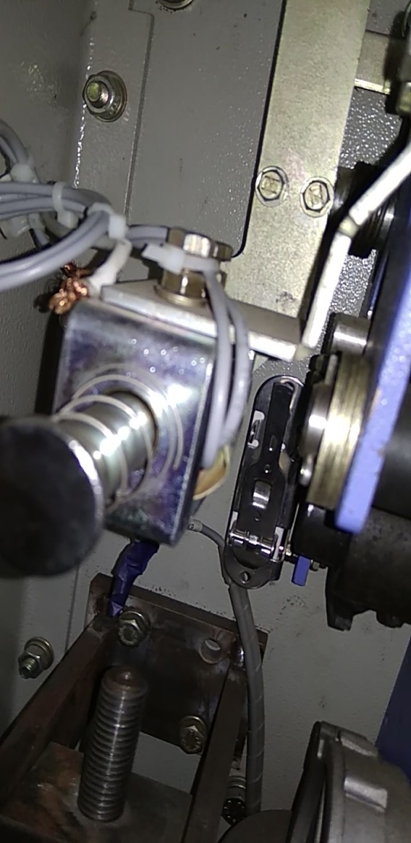

CLOSING
The closing coil with its latch assembly holds the closing spring force, which is waiting for the signal to close the circuit breaker or by manually.
The latch holds the curved arm with is connected to the main shaft.

Slide 10
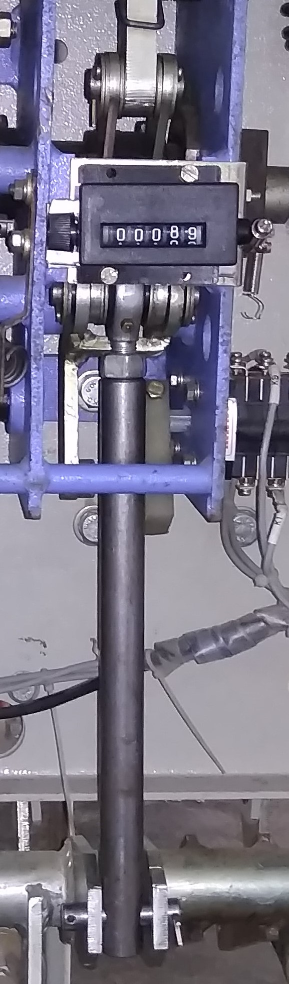
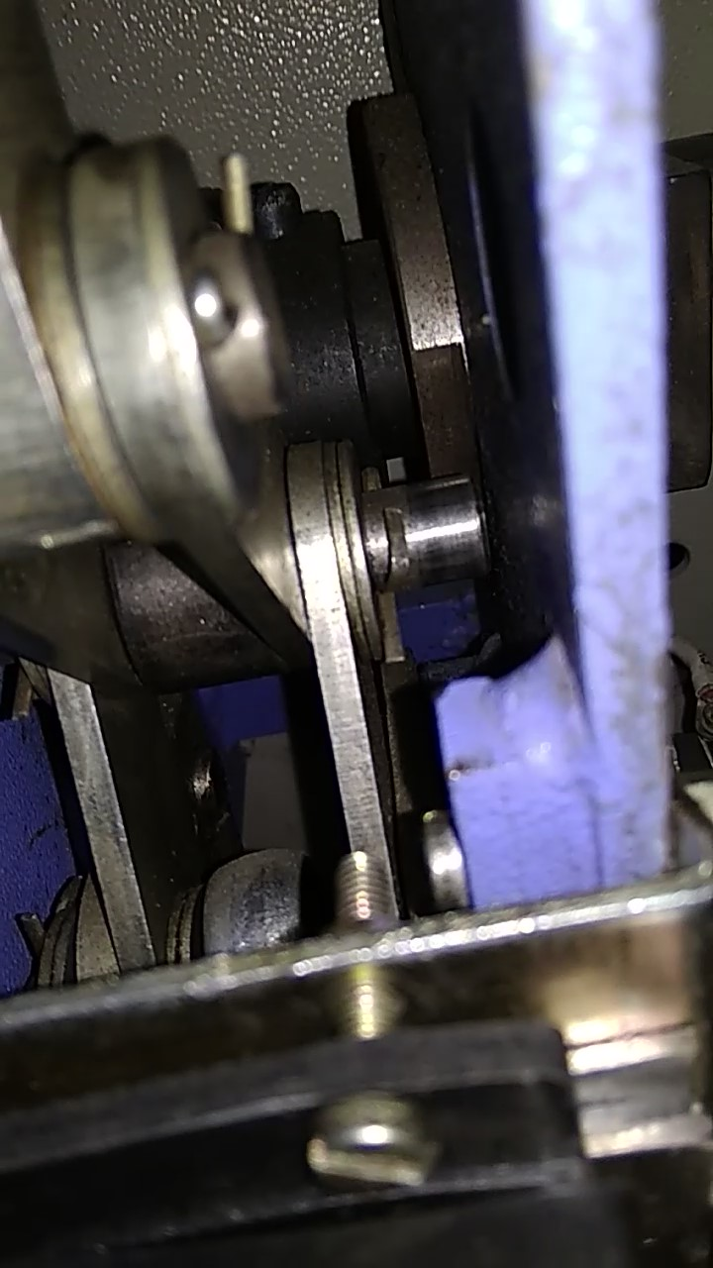
On pushing the closing coil the latch releases the arm to rotate with the main shaft thereby the closing cam hits the linkage associate with a roller.
Now the main drive rod rotates the main drive shaft.
CAM
MAIN DRIVE ROD LINKAGE

Slide 11
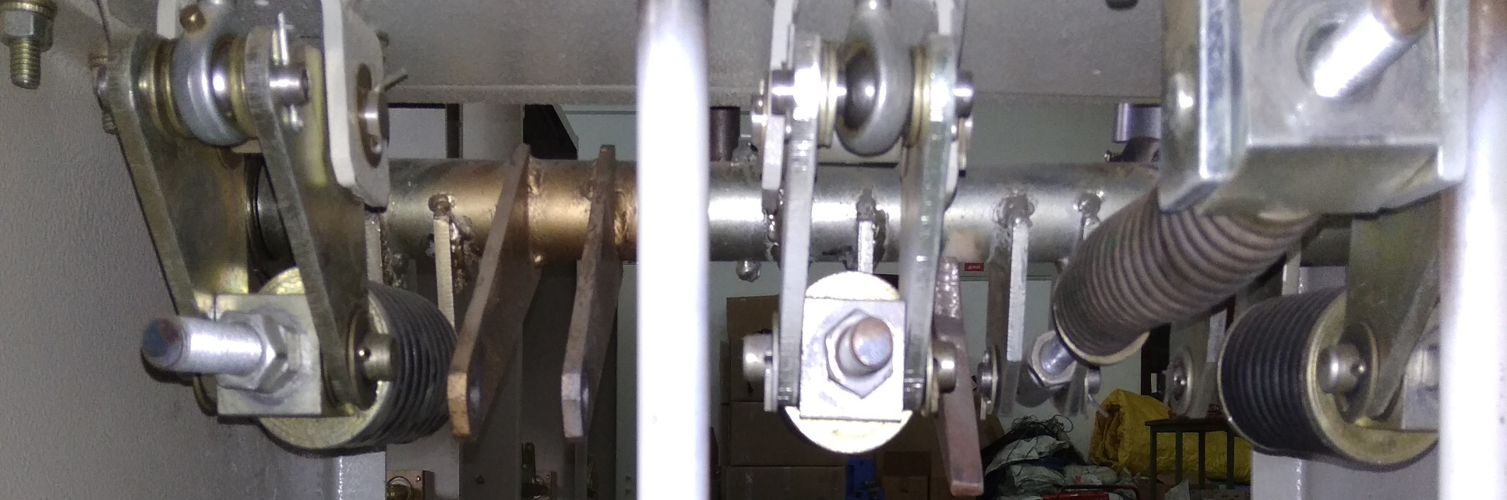
The contact spring is now compressed and forces the bell crank to lift the pole drive rod.
The purpose of contact spring is provided to overcome the repulsive force due to short circuit & to maintain strong contact of the buds of vacuum interrupter.
Hold open spring is provided to return additional forces on tripping.

Slide 12
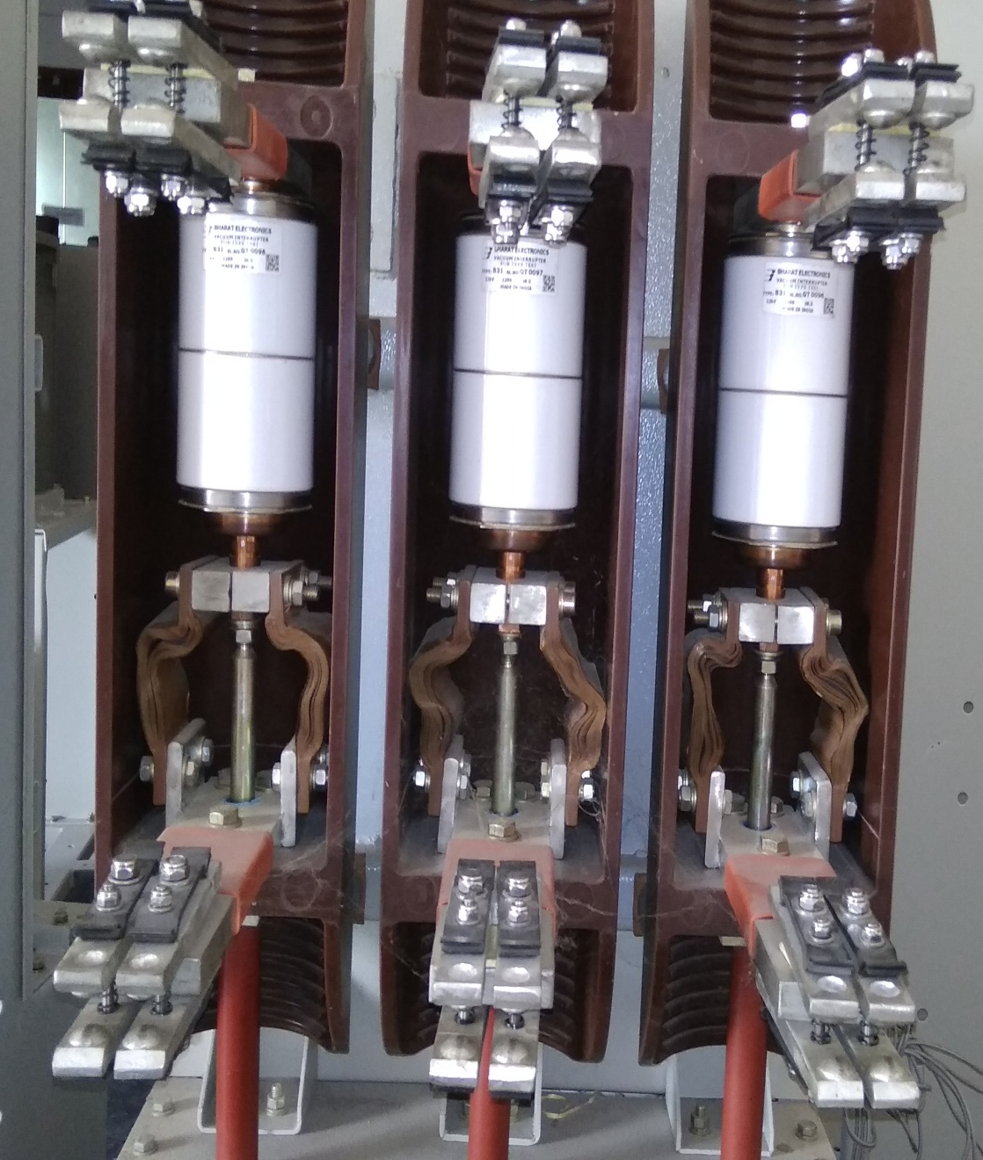
The pole drive rod attached with the vacuum interrupter now closes the circuit.
The bud like structure is made to contact with each other.
Now the current flows between the top & the bottom terminals

Slide 13
OPENING/TRIPPING
When the open coil is pressed or on receiving signal the open latch assembly rotates and releases the pressurised arm and loosens the linkage.
With the help of hold open spring force the vacuum interrupter trips and opens the circuit.

Slide 14
THANKYOU

